Slide 1
Alzheimer’s Disease Trends in the United States and Tennessee from 1999-2018
Capstone Project for Nashville Software School Data Analytics Cohort 2
John Posey
Data Analyst
Notes:
Thank you for coming to my Capstone presentation for Nashville Software School on Alzheimer's Disease fatality trends over the past 20 years. I have a personal attachment to this disease due to it being a true fear of mine and having family members that have had dementia in the later years of their lives.
This presentation will be broken down in the following areas: 1. How AD affects the brain and cognitive ability. 2. Trend overall in the United States from 1999-2018. 3. Trend in Tennessee from 1999-2018. 4. How can you find help if you or someone you love has AD? 5. Resources
6.Introduction to what the parts of the brain are, and what they control.

Slide 2
Alzheimer’s Disease pathology and presentation
What Alzheimer’s Disease is?
how it affects those diagnosed?

Slide 3
What is Alzheimer’s Disease?
According to the Alzheimer’s Association, Alzheimer’s is a subset of a mental disorder known as Dementia. It affects memory, thinking and overall behavior. Symptoms can eventually grow severe enough that they interfere with daily everyday tasks.

Slide 4
Understanding Alzheimer’s
Alzheimer’s is the most common form or cause of Dementia. Dementia is a general term for loss of memory or other cognitive abilities.
Alzheimer’s accounts for 60-80% of Dementia cases.
Alzheimer’s is not a normal part of aging. There are numerous cases of early-onset Alzheimer’s (which is anyone under 65 years of age)
Alzheimer’s currently has no cure. Treatment for symptoms is the best available course of action.
A few quick facts about Alzheimer’s disease:
Notes:
Note on #2: the other most common causes being Vascular Dementia and Parkinson’s Disease.

Slide 5
Alzheimer’s Disease, Brain Function, and Cognitive Decline
Ad’s effect on brain function and the resulting cognitive decline.

Slide 6
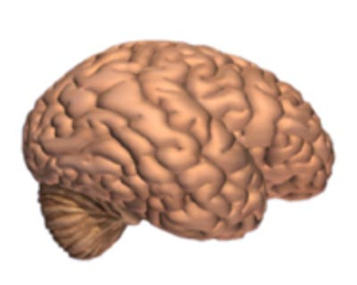
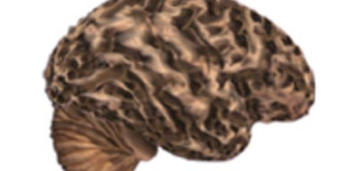
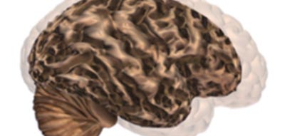
Alzheimer’s leads to nerve cell death and loss of brain tissue. The brain shrinks dramatically, greatly affecting functions.
Brain without Alzheimer’s Disease.
Brain with advanced Alzheimer’s
Comparison image of the two
No noticeable brain tissue degradation
Noticeable tissue degradation
See the difference between the two models.

Slide 7
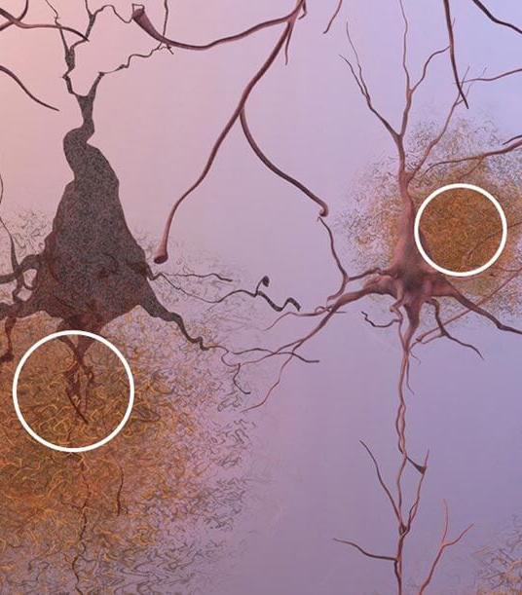
Formation of Plaques
Plaques, which are abnormal clusters of fragments of protein, gather and build up between and around the nerve cells. This picture is of brain tissue under a microscope. Scientists and Doctors are not sure what causes cell death and loss of tissue, but plaques and tangles are the current theories.

Slide 8
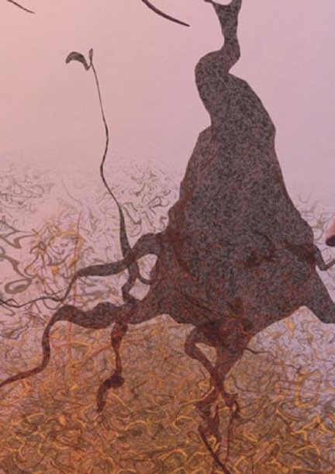
Tangles
Dead and dying nerve cells containing tangles which are twisted strands of a different protein.

Slide 9
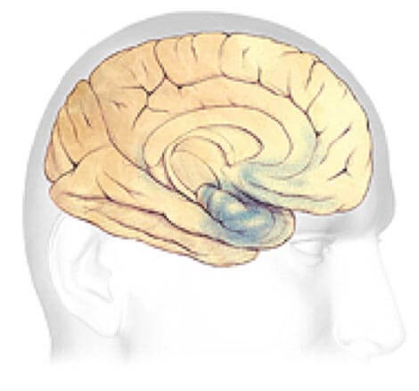
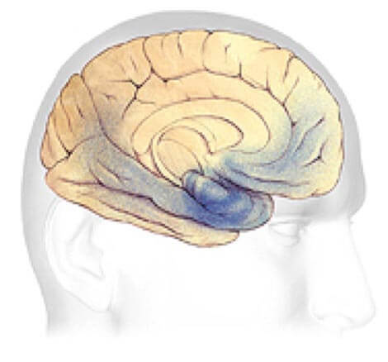
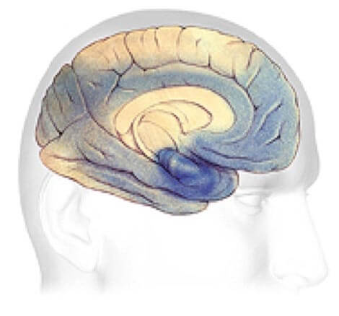
Plaque and Tangle Progression Plaque and Tangles (shown in blue) spread through the cortex. Rate of progression varies wildly from case to case.
Early Alzheimer’s
Mild to Moderate Stages
Severe, late stage
Changes to brain can begin 20 years or more before diagnosis.
Generally, lasts between 2-10 years
May last from 1-5 years.

Slide 10
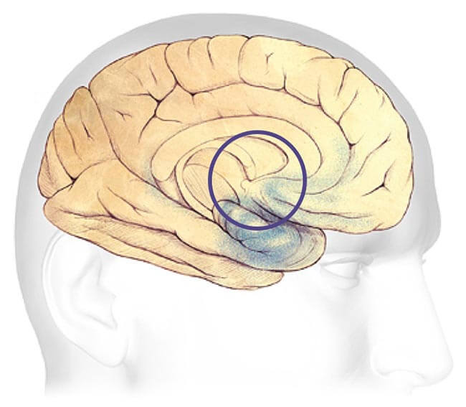
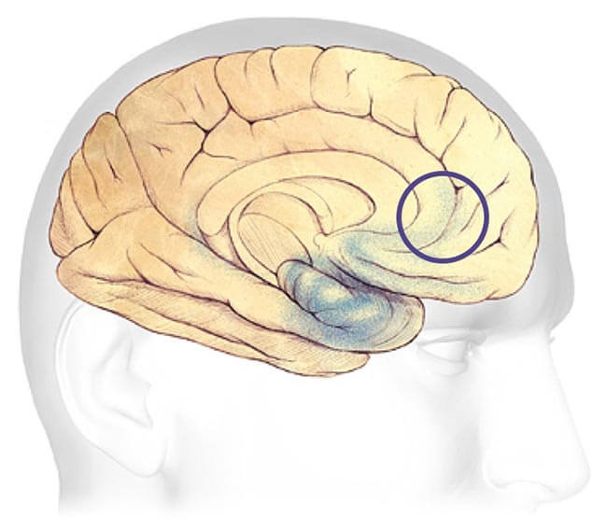
Earliest Alzheimer’s Stages
Before symptoms can be detected with tests, the plaques and tangles begin forming in the areas of the brain most involved with:
Learning and Memory
Thinking and Planning

Slide 11
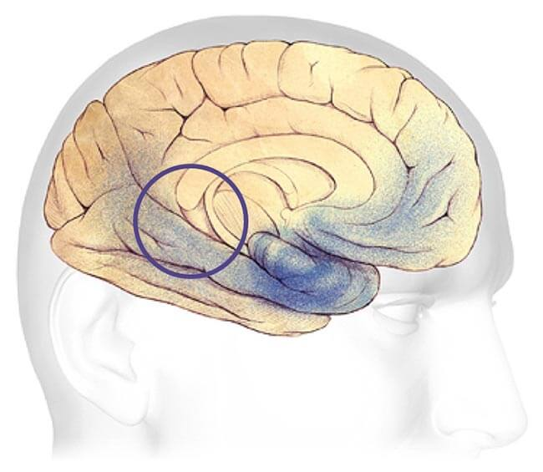
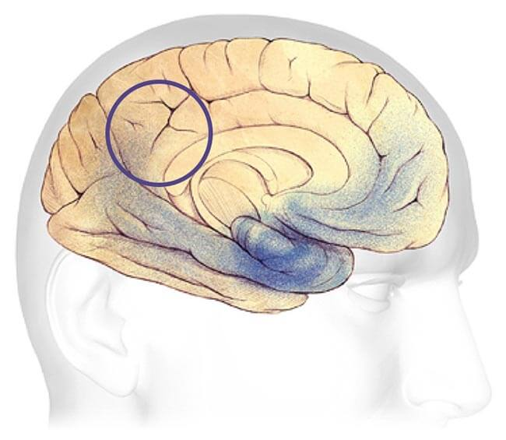
Mild - Moderate Alzheimer’s Stages
Most common stage of diagnosis. Develop problems with memory or thinking that affects daily life. Might also start getting confused and have issue handling money, expressing themselves, or even organizing thoughts.
Speaking and Understanding Speech
Sense of bodily position to objects

Slide 12
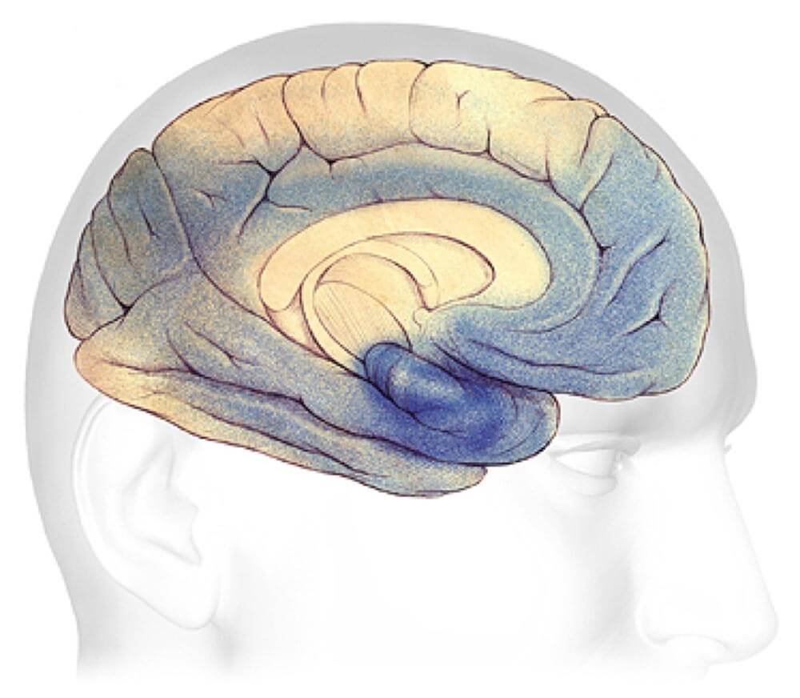
severe Alzheimer’s Stage
Most of the cortex has been severely damaged. Brain will shrink dramatically due to widespread brain cell death.
Loss of ability to communicate
Failure to recognize family or loved ones or care for self

Slide 13
Power Bi Presentation
Alzheimer's Disease Presentation

Slide 14
What to do if You or someone you love has Alzheimer’s Disease?
A short guide for Family and friends

Slide 15
First Steps
Don’t Panic.
There is support and a community there for you and/or your loved one.
Talk to your Doctor.

Slide 16
next Steps
Contact your local Alzheimer’s Association.
They can help with getting you in touch with AD and Dementia specialists in your area.
Start making legal and financial plans.

Slide 17
Further Steps
Live Well.
Reduce Stress
Embrace your community
Become an Advocate or Leader
Participate in Clinical Trials
Help to overcome the stigma

Slide 18



Resources
Links to various organizations and programs for help.
Tennessee Chapter

Slide 19
More Resources
24/7 Helpline
1-800-272-3900
Education Programs
Alzheimer’s Association Programs
https://www.alz.org/help-support/i-have-alz/programs-support

Slide 20

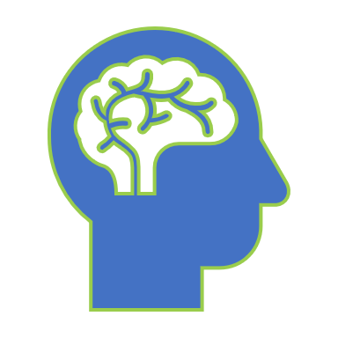
How does your Brain work?
Notes:
First, we will start by briefly describing the main portions of the brain and what they do.

Slide 21
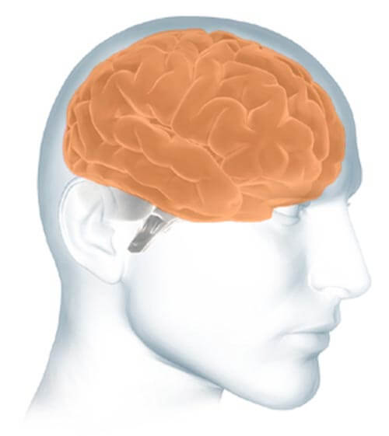
Parts of the Brain
The cerebrum fills up most of your skull. It is involved in remembering, problem solving, thinking, and feeling. It also controls movement.
https://www.alz.org/alzheimers-dementia/what-is-alzheimers/brain_tour

Slide 22
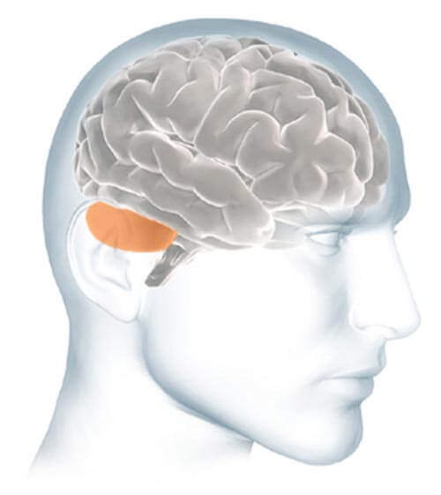
Parts of the Brain
The cerebellum sits at the back of your head, under the cerebrum. It controls coordination and balance.
https://www.alz.org/alzheimers-dementia/what-is-alzheimers/brain_tour

Slide 23
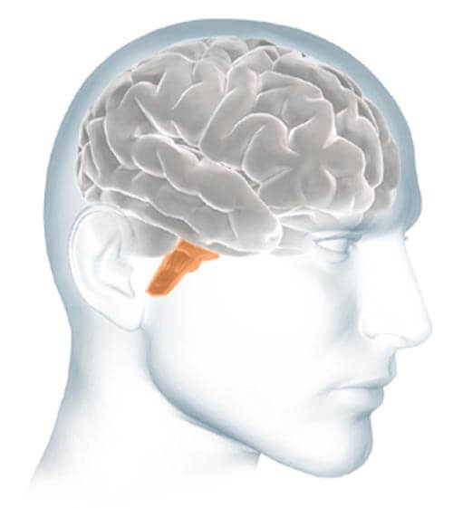
Parts of the Brain
The brain stem sits beneath your cerebrum in front of your cerebellum. It connects the brain to the spinal cord and controls automatic functions such as breathing, digestion, heart rate and blood pressure.
https://www.alz.org/alzheimers-dementia/what-is-alzheimers/brain_tour

Slide 24
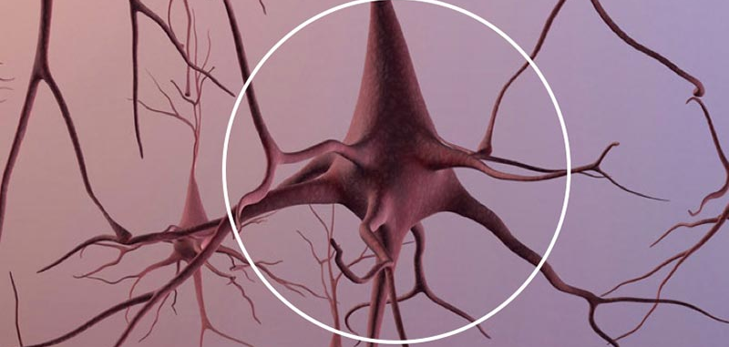
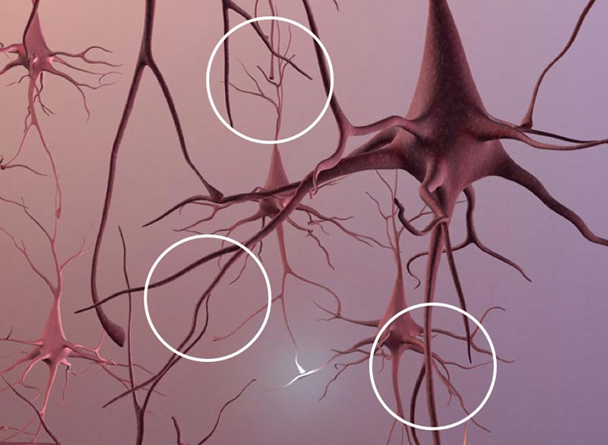
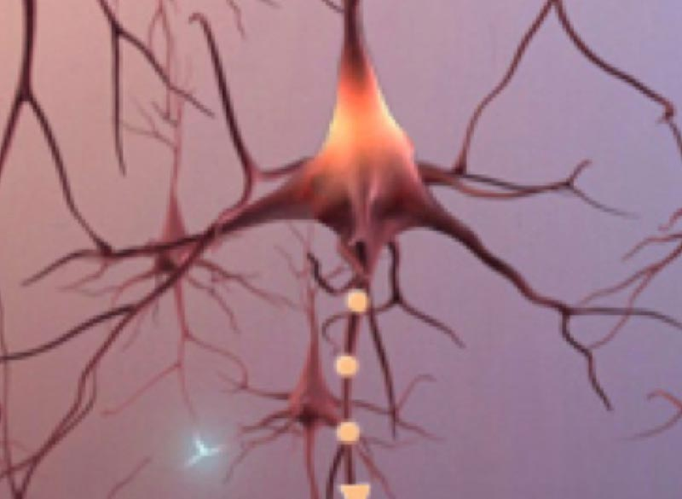
Neurons
Total Neurons
Branches
Signals
An adult brain contains about 100 billion nerve cells.
Branches connect the nerve cells at more than 100 trillion points. Scientists call this dense, branching network a "neuron forest."
Signals traveling through the neuron forest form the basis of memories, thoughts, and feelings.
Notes:
Next, we will look at the neurons. Neurons are cells within the nervous system that transmit information.

Slide 25

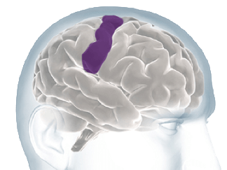
Interpret Sensations From Your Body
Notes:
Now, we will look at the portion of the brain known as the Cortex.
There are multiple points of the Cortex:
Briefly these are the
1. Renal Cortex
2. Adrenal Cortex
3. Thymic Cortex
4. Cerebral Cortex, where most of the effects of Alzheimer’s Disease take place.

Slide 26
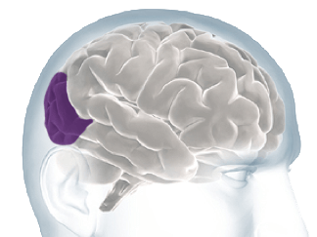
Processing Sights

Slide 27
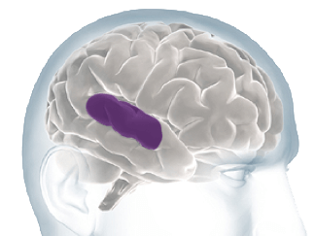
Processing Sounds

Slide 28
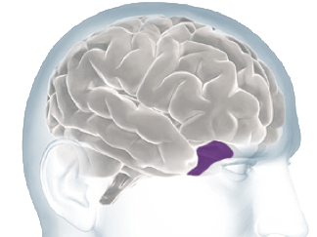
Processing Smells

Slide 29
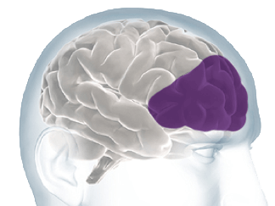
Thoughts, Problem Solving And Planning

Slide 30
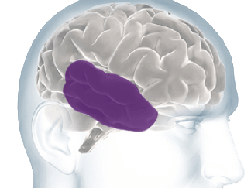
Forming & Storing Memories

Slide 31
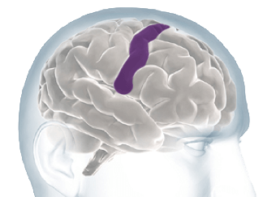
Controlling Voluntary Movement

